Slide 1
Data Structure
Lecture#7

Slide 2
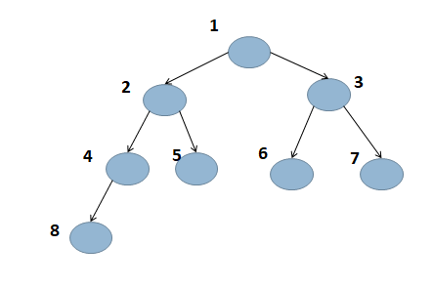
Binary Tree
Each node can have at most two children.
Having left and right child

Slide 3
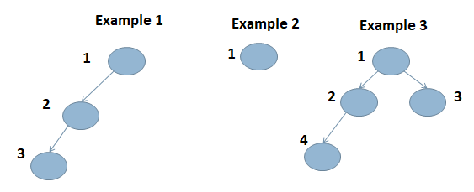
Binary Tree (cont.)
Examples of Binary Tree:

Slide 4
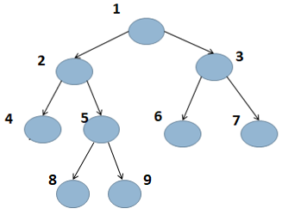
Binary Tree (cont.)
Strict Binary Tree
Also known as proper binary tree
Each node has either 0 or 2 children

Slide 5
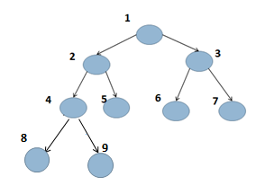
Binary Tree (cont.)
Complete Binary Tree
All levels except possibly the last are filled and all nodes are as left as possible.

Slide 6
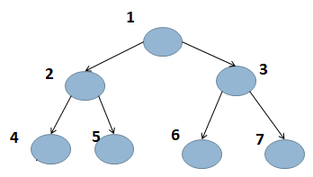
Binary Tree (cont.)
Perfect binary tree
In which all the levels are filled

Slide 7
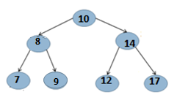
Binary Search Tree
A type of binary tree in which for each node, value of all the nodes in left sub tree is lesser and value of all the nodes in right sub tree is greater than root

Slide 8
Binary Tree Traversal
Breadth First or Level Order Traversal
Depth First Traversal
Inorder
Preorder
Postorder

Slide 9
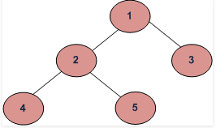
Binary Tree Traversal
Depth First Traversals: (a) Inorder (Left, Root, Right) : 4 2 5 1 3 (b) Preorder (Root, Left, Right) : 1 2 4 5 3 (c) Postorder (Left, Right, Root) : 4 5 2 3 1
Breadth First or Level Order Traversal : 1 2 3 4 5

Slide 10
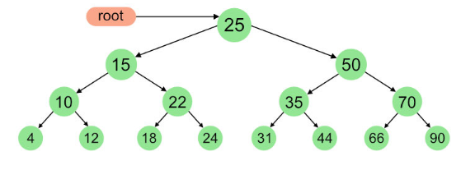
Binary Tree Traversal(cont.)

